Slide 1
E-retail factors for customer activation and retention: A case study from Indian e-commerce customers
By :
RAVINDER SINGH

Slide 2
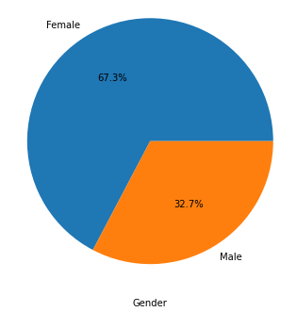
GENDER
The women are almost twice than men who have taken this survey.
To see quick results for any change you make on your E-store they can be target customers

Slide 3
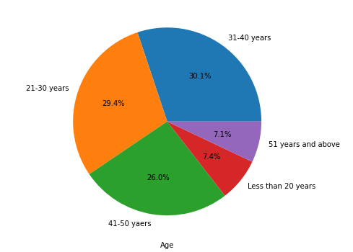
AGE
Majority of the people taking this survey are in their 30's followed by 20's, teenagers and senior citizen are the least in number.
Target age group is 20-50

Slide 4
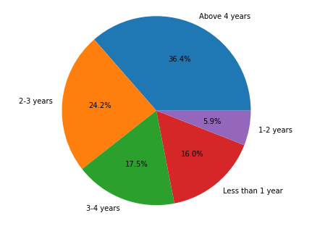
Shopping Since
Majority of the people taking this survey shopping online have been shopping from a long time.
But there is a 16% of increase in last year only

Slide 5
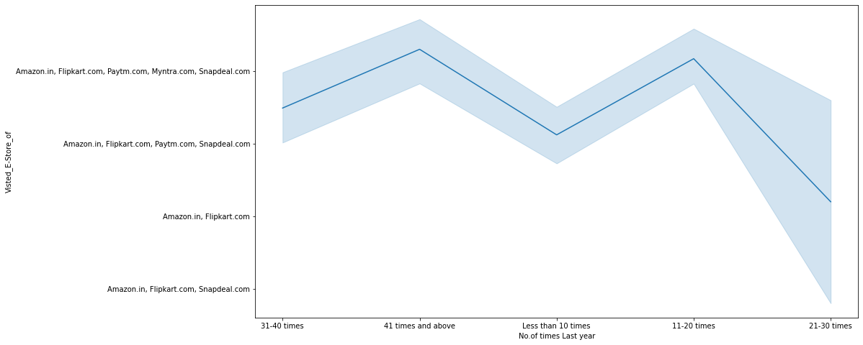
Intention of Repeat purchase:
1.Heavy shoppers who shop more than 41 times a year shop from all the online brands
2.People shopping less than 10 times a year seem to exclude myntra (prefer amazon,flipkart,snapdeal,paytm)
3.People shop from Amazon and flipkart whatever be the case.

Slide 6
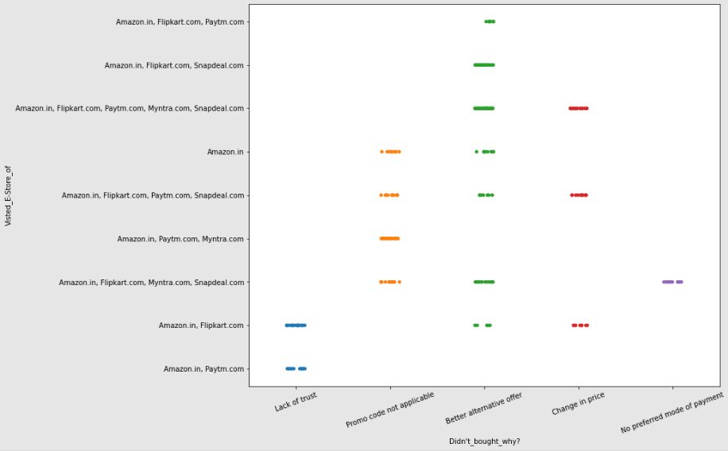
E-stores v/s Reason not to Buy
Majority of the time people abandon the bag is because they get a better alternative offer or promo code not applicable.
Change in price is also a reason (Hidden charges)
There is also lack of trust seen in amazon, flipkart and paytm by some people.

Slide 7
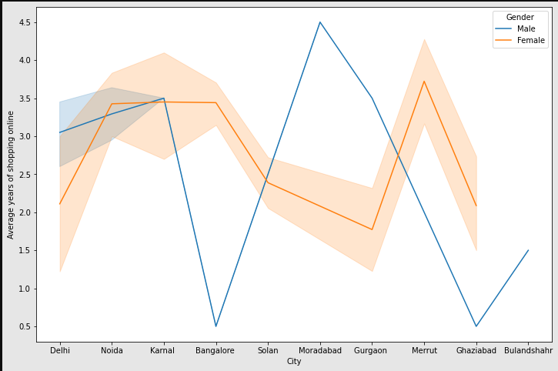
City v/s Average years (Gender) OBSERVATIONS
Highest number of men shopping online belong from delhi and noida, while men from Moradabad have been shopping online for the longest.
Women from meerut and noida have shopped the longest.
Men living in Banglore and Ghaziabad shop have shopped online for less than 1 year.
Notes:
lines Graph shows density of female customers is more than male(survey is taken by females more than male)
Highest number of men shopping online belong from delhi and noida, while men from Moradabad have been shopping online for the longest.
Women from meerut and noida have shopped the longest.
Men living in Banglore and Ghaziabad shop have shopped online for less than 1 year.

Slide 8
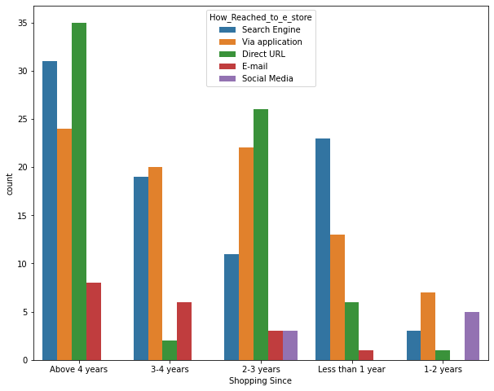
How_Reached_to_e_store
Traffic to the e-stores are not Only through the Application people are shopping through direct urls and search Engine
Search Engine optimisation can increase traffic on the E store
Social media is also becoming important to these sites

Slide 9
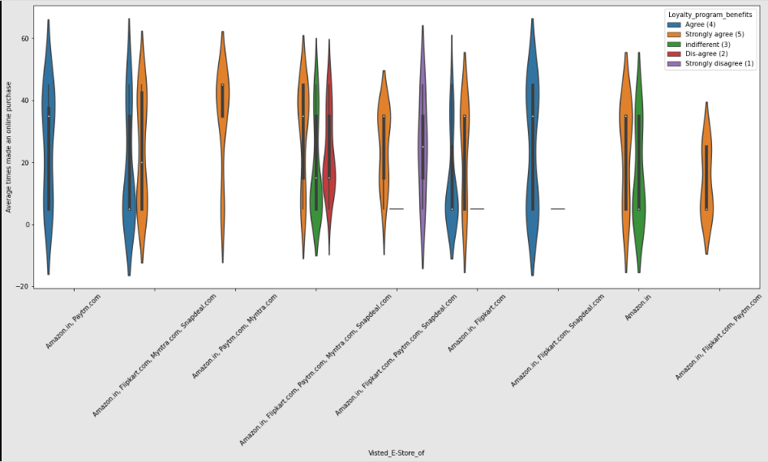
Loyalty program benefits
People shopping from amazon and paytm are getting benefits from the loyalty points
flipkart and snapdeal also seems to give such benefits
Contrary People who shop from almost everywhere disagree with this statement too

Slide 10
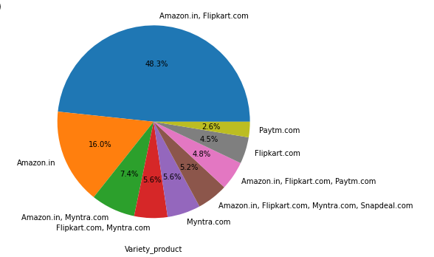
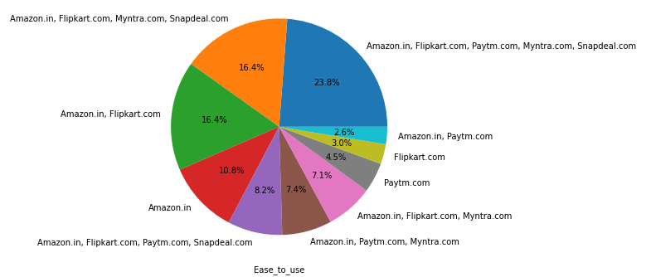
Brand image (1)

Slide 11
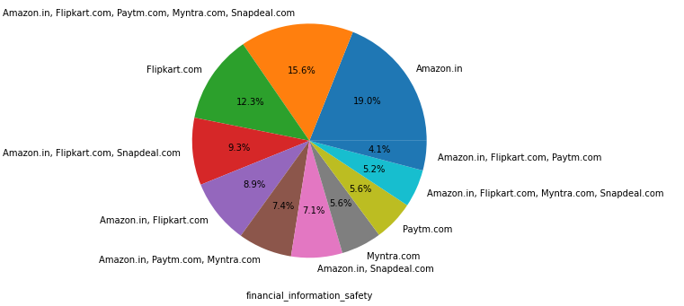
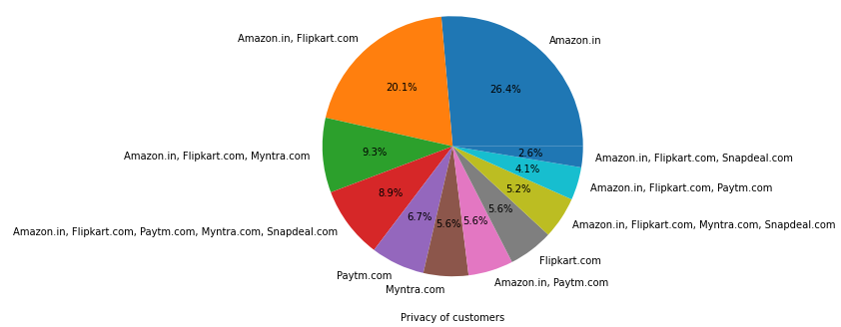
Brand image(2)

Slide 12
Brand Image(conclusion)
Ease to use, Financial information security, privacy of customer, variety of product
Amazon, Flipkart have been had the highest votes and have maintained a very good brand image followed by Paytm and the Myntra.

Slide 13
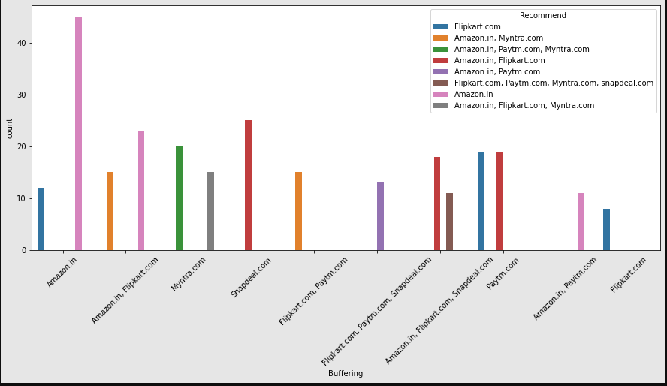
Recommendv/s neagtive to the E-store (1)

Slide 14
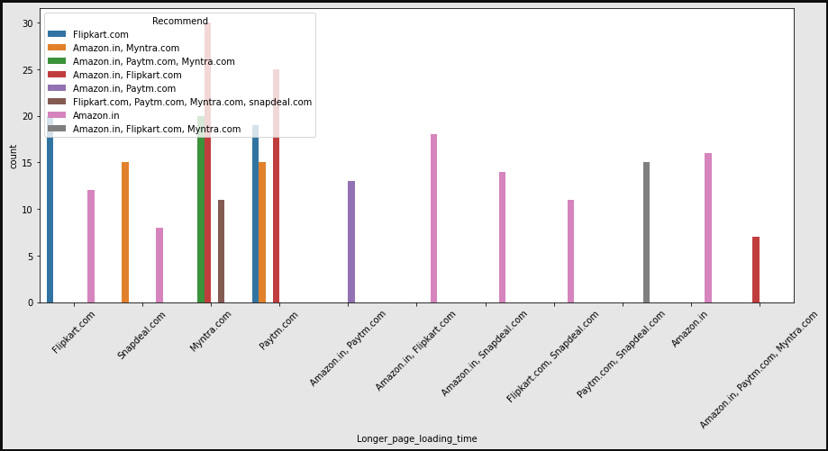
Recommend v/s neagtive to the E-store(2)

Slide 15
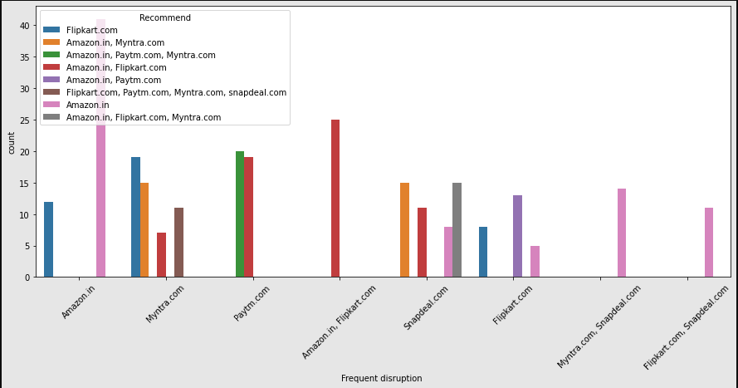
Recommend v/s neagtive to the E-store(3)

Slide 16
Recommendation v/s Bad experience
Customers seem to be more loyal to amazon, flipkart and paytm as even though many of them have given negative remarks about them still they would recommend these platforms to their friend
There no better alternative to these Giants Currently
E-Commerece should work on the website/App interface, loading speed,buffering, graphic speed to ease customer experience

Slide 17
Suggestions
The cost of the product, the reliability of the E-commerce company and the return policies all play an equally important role in deciding the buying behaviour of online customers.
The return policies are important because in online retail customer does not get to feel the product. Thus, he/she wants to be sure that it will be possible to return the product if he does not like it in real.
The cost is an important factor as it was the basic criteria used by online retailers to attract customers. The reliability of the E-commerce company is also important, as it is even required in offline retail. It is important because customers are paying online, so they need to be sure of security of the online transaction.
All the websites Unequally preferred by online customers. Amazon was the most preferred followed by Flipkart. These two companies are most trusted in the industry and hence, have a huge reliability. Also, the sellers listed on these websites are generally from Tier 1 cities as compared to Snapdeal and PayTM which have more sellers from tier 2 and 3 cities. Also, these websites have the most FLEXIBLE return policies as compared to others and also the time required to process a return is low as well.
Social media is also important to gain new customers.
As the traffic to the e-store is through Search engine mostly Search Engine optimization can increase some traffic

Slide 18
Thank you
REFRENCES:
Refer the ipynb file for better understanding of the conclusion
https://github.com/Ravinder-Singh-1993/internship/blob/main/Customer_Retition/Customer_Activation_Retention.ipynb

